Slide 1
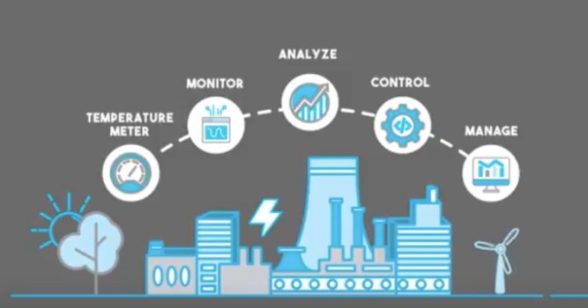
IOT ENERGY TRAINING
Jul, 2024
PT. Panasonic Industrial Devices Batam
Smart Factory-MO Department

Slide 2
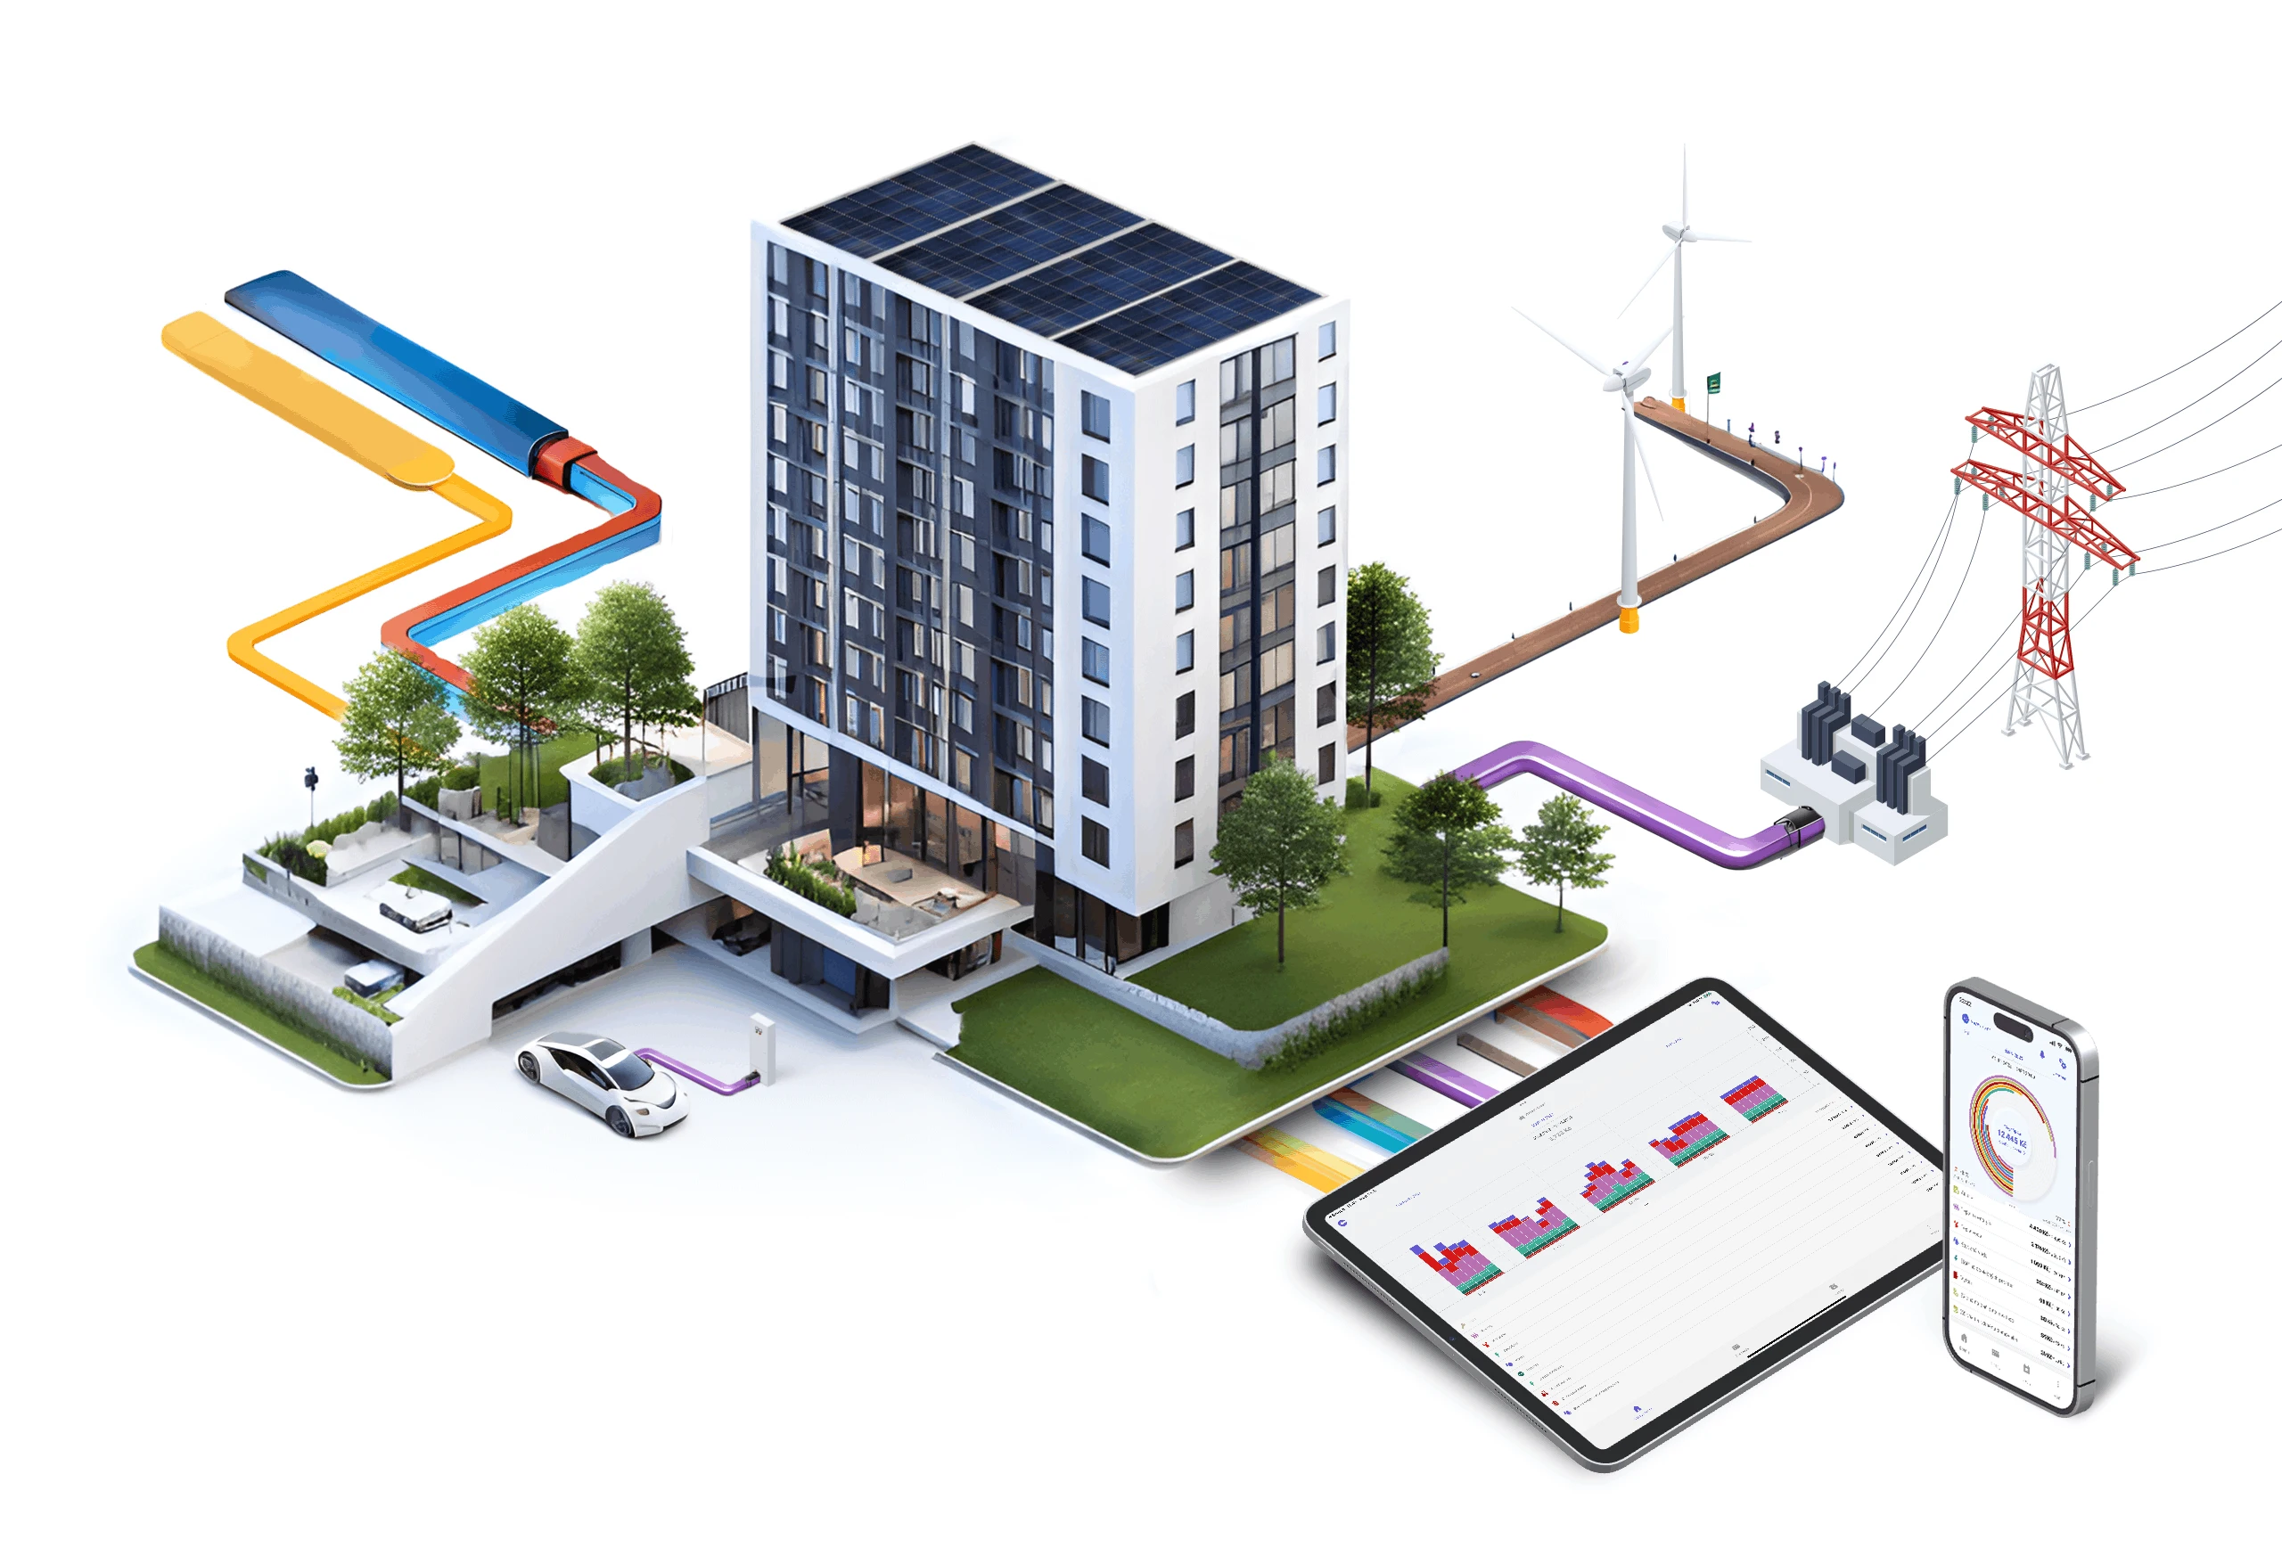
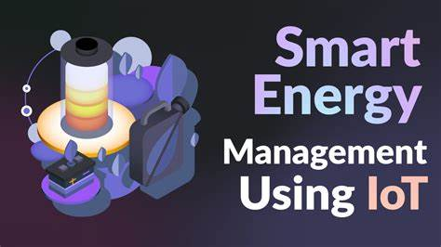
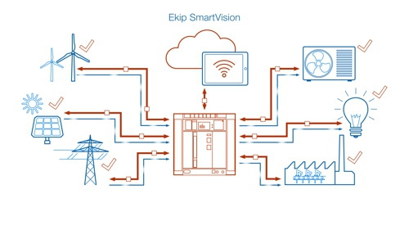
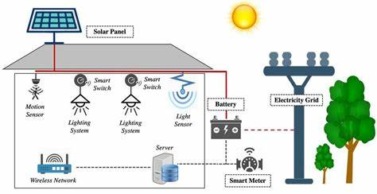
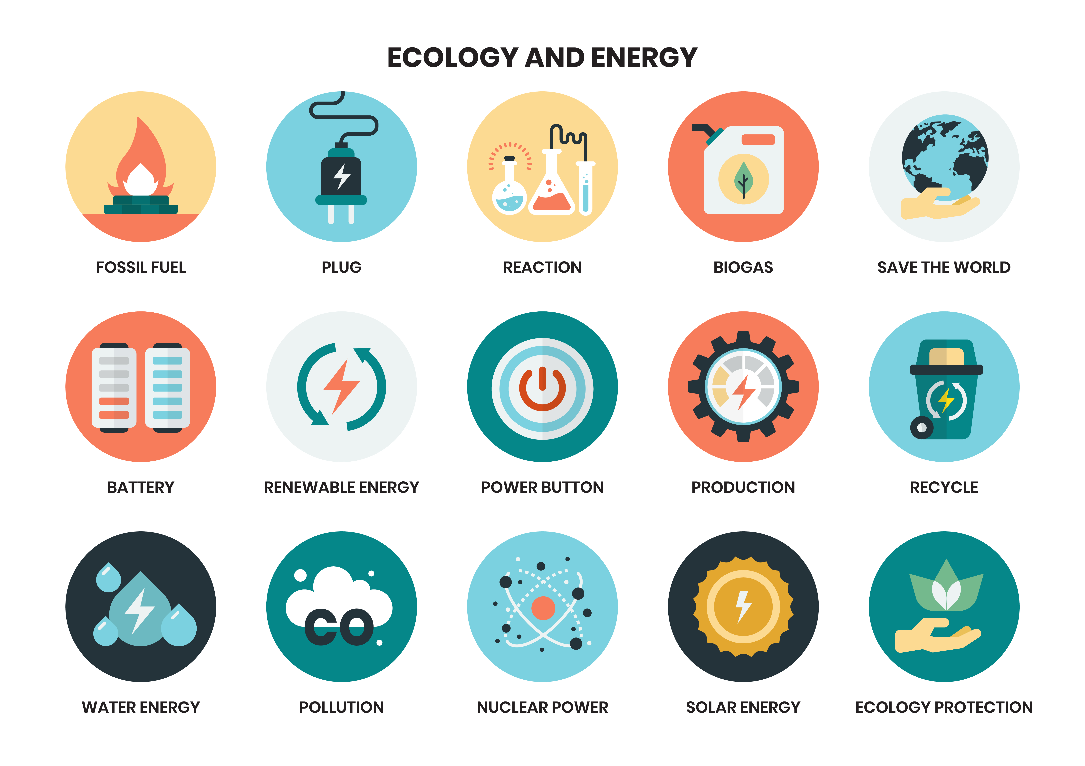
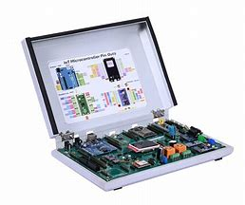
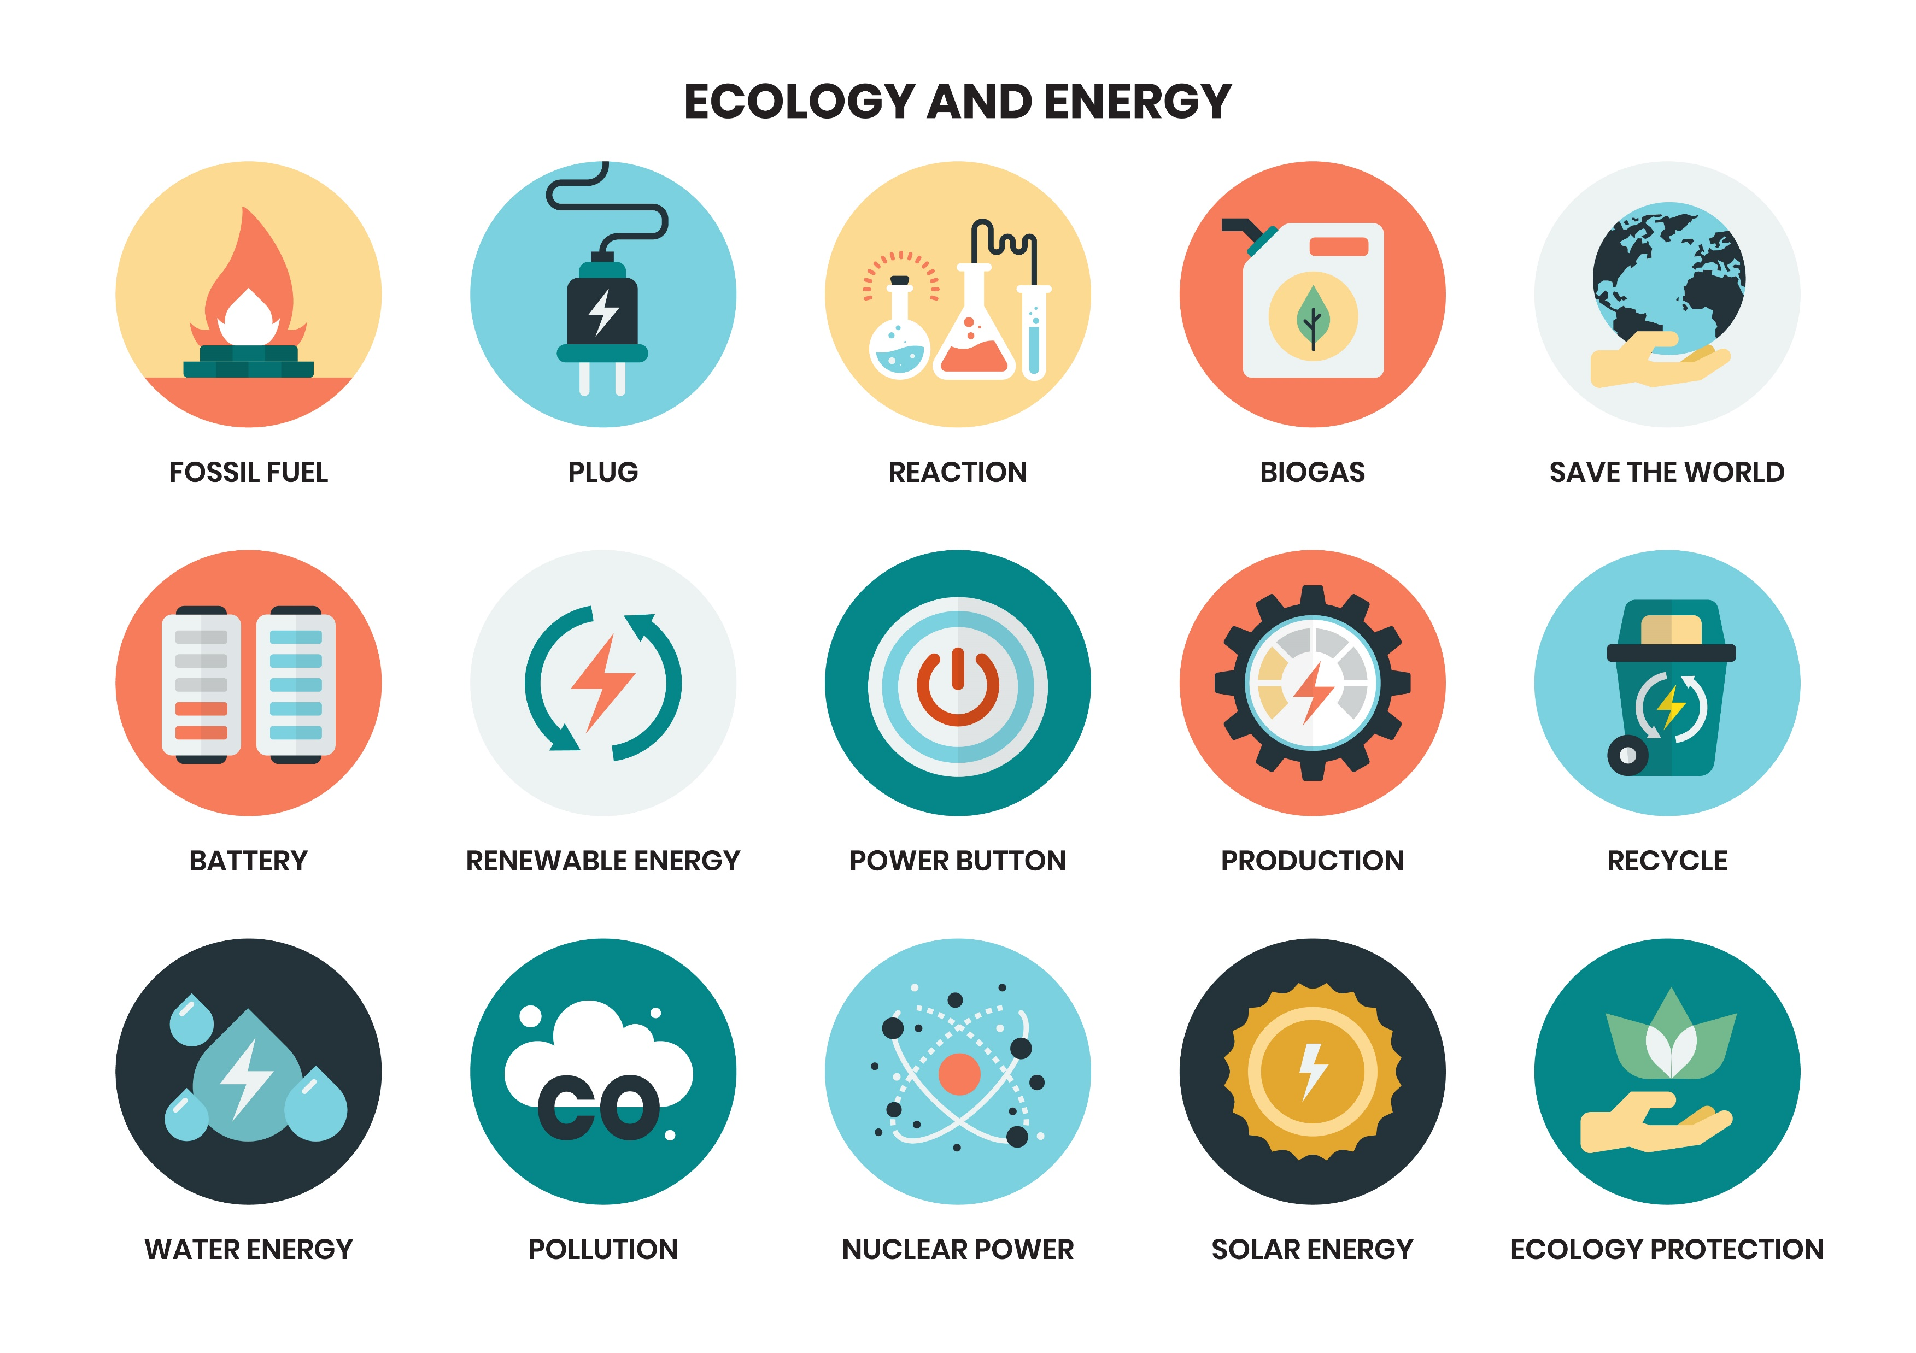
IOT ENERGY CONSERVATION TRAINING KIT
Panasonic Industrial Devices Singapore Pte. Ltd.
PT Panasonic Industrial Devices Batam
BACKGROUND
OBJECTIVE
Modern industries encounter significant energy efficiency challenges impacting both costs and environmental sustainability. While IoT technology provides advanced solutions through real-time energy monitoring and management, its adoption remains constrained due to its nascent status. This training initiative, led by PIDBT, seeks to advance industry professionals' understanding and application of IoT solutions, thereby enhancing cost reduction, regulatory compliance, and sustainability efforts.
IoT Technology in Energy: Explore IoT applications in energy.
IoT Management Skills: Implement IoT technology for energy.
IoT Energy Data Analysis: Analyze energy data using IoT.
Energy Optimization with IoT: Apply IoT for energy efficiency.
Regulatory Compliance and Sustainability: Ensure energy compliance through IoT.

Slide 3
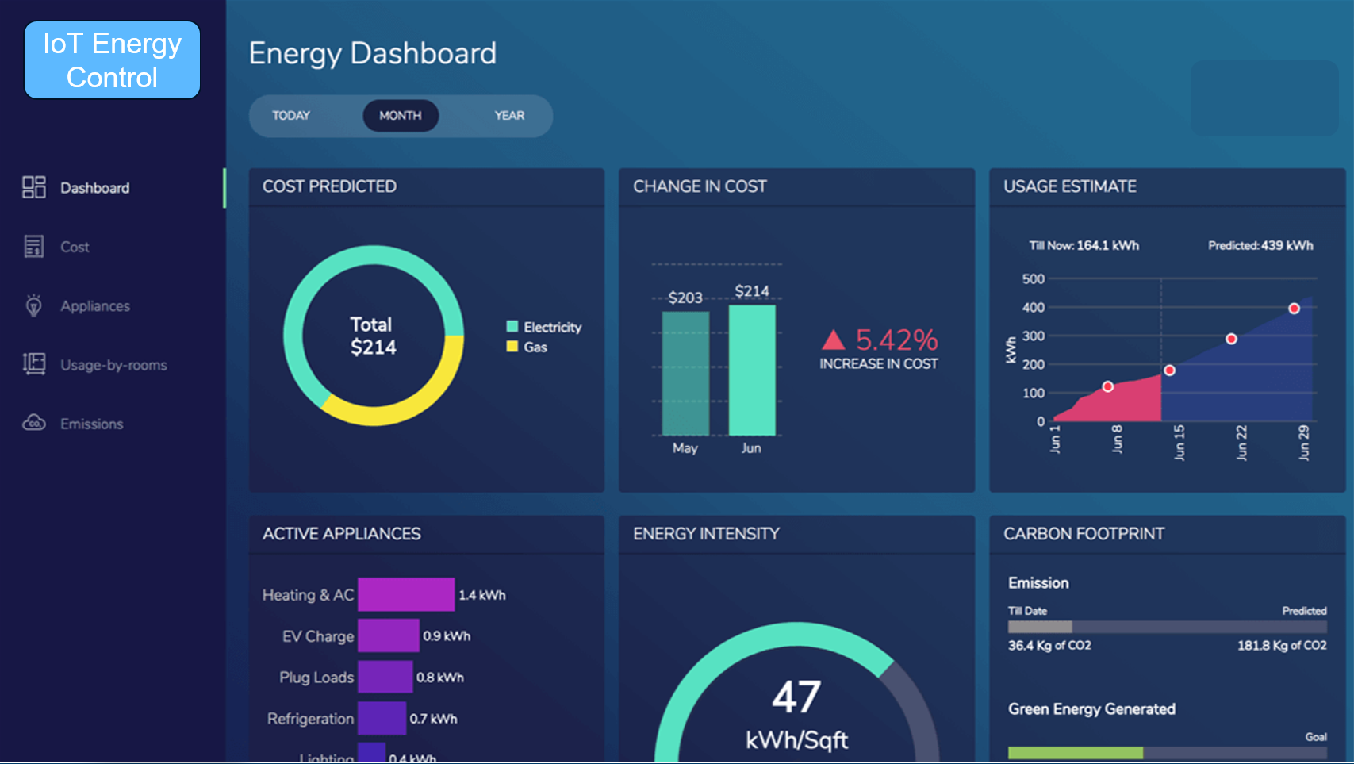
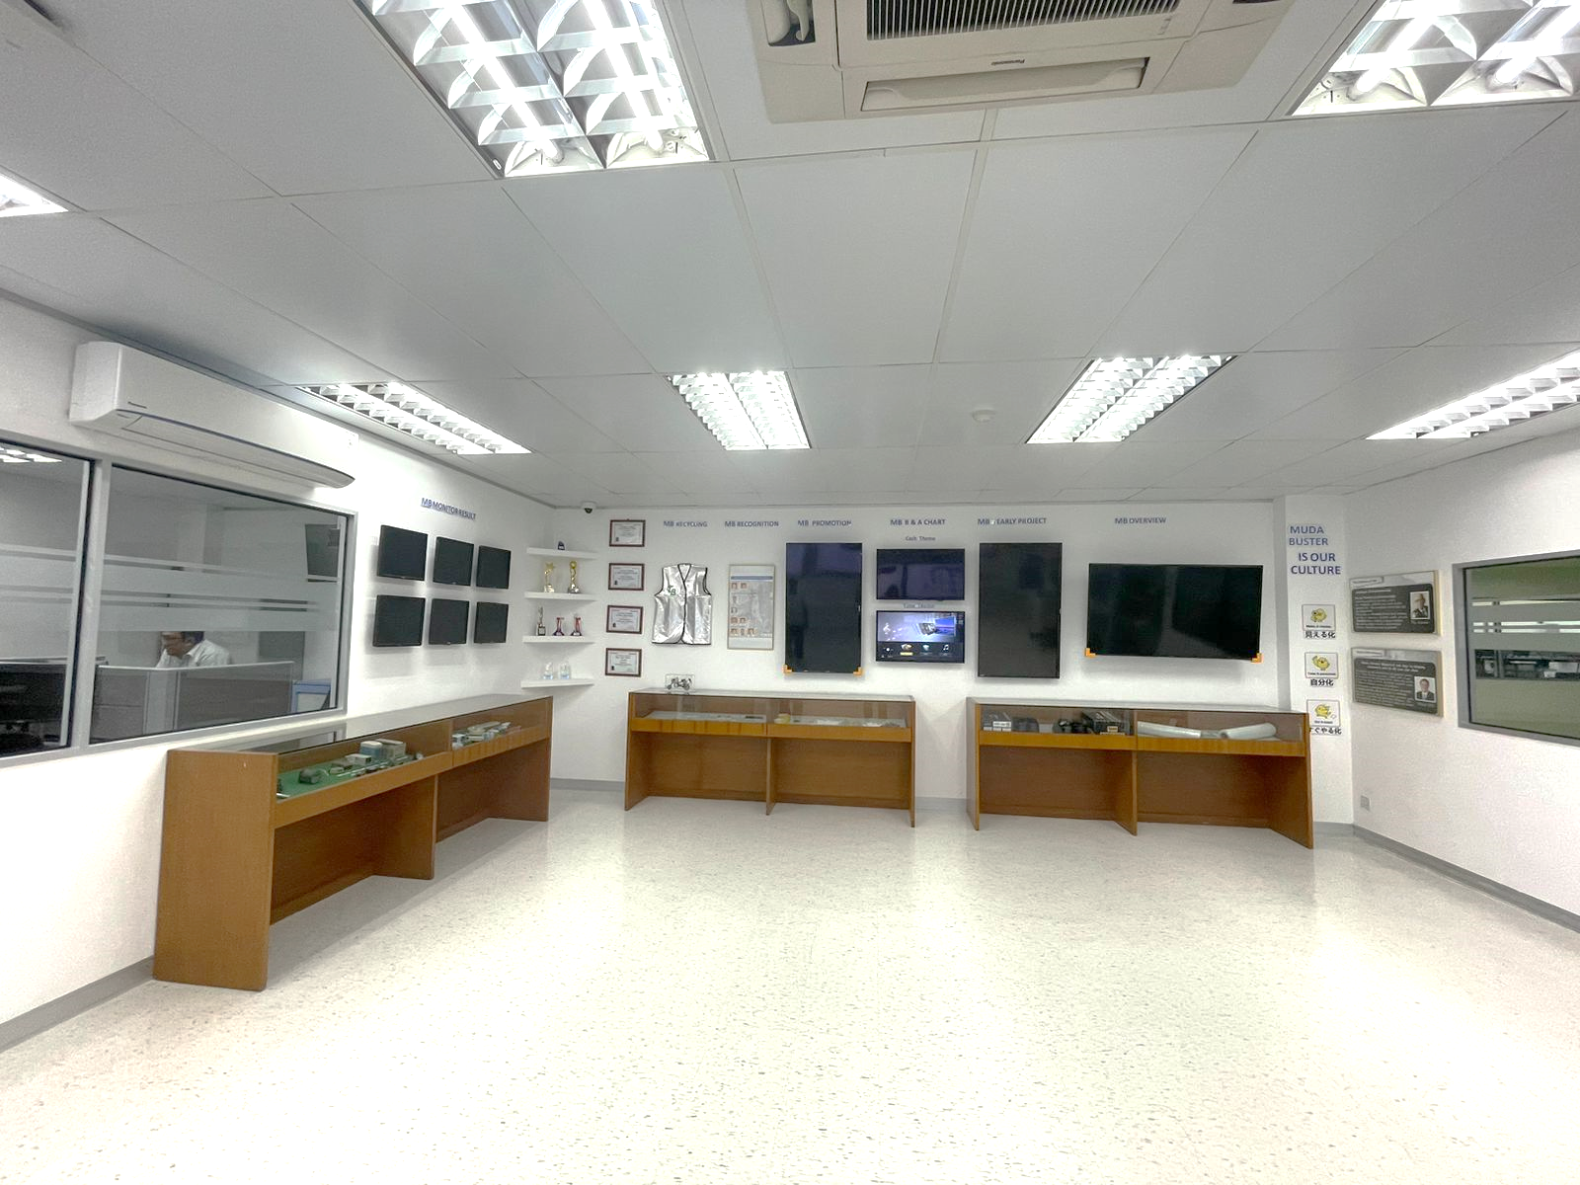

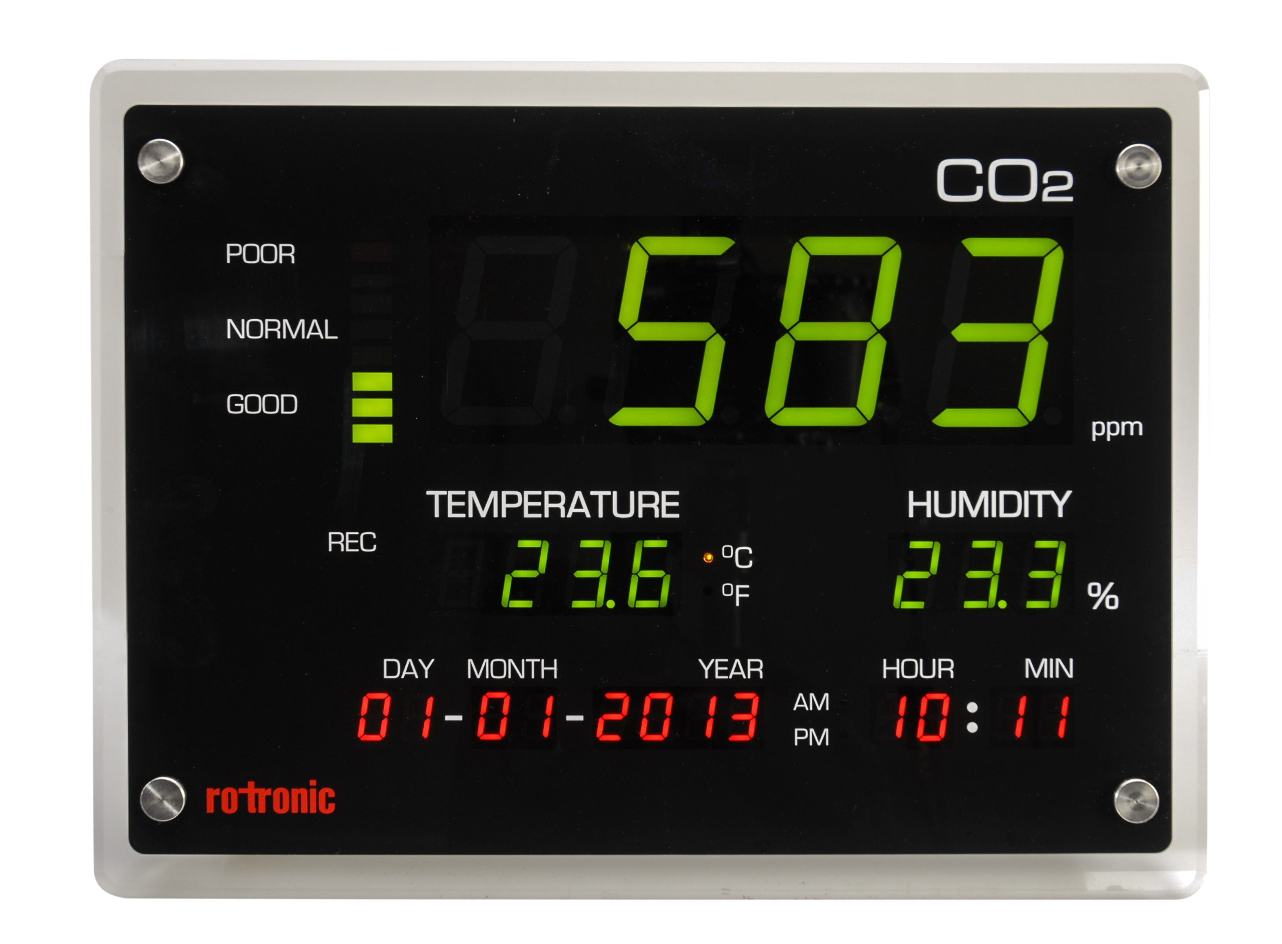

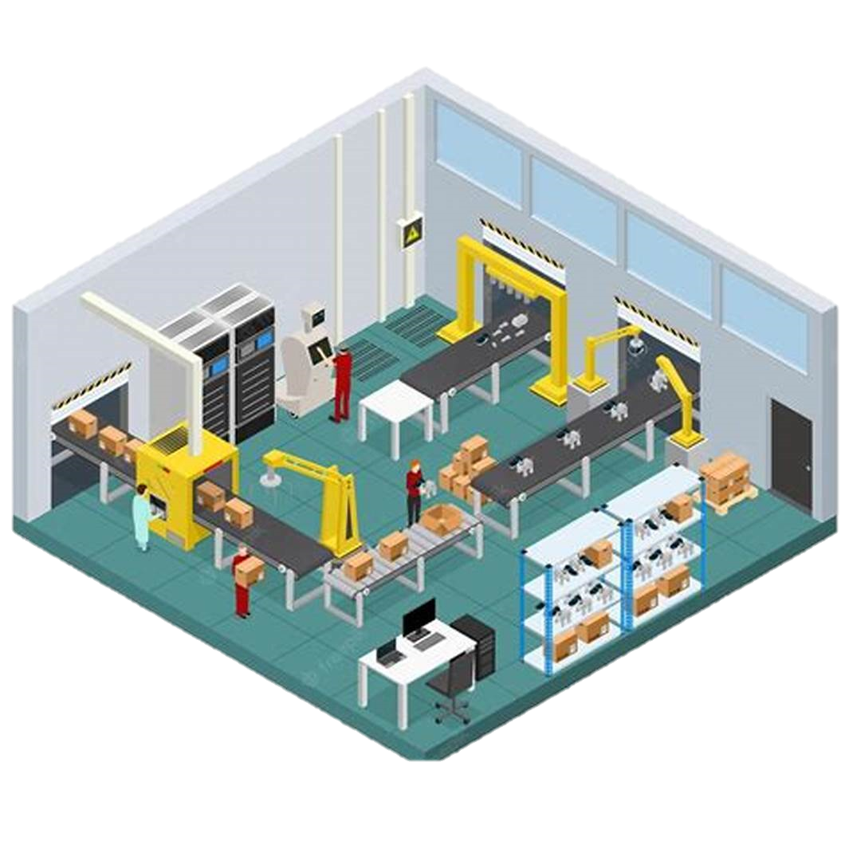
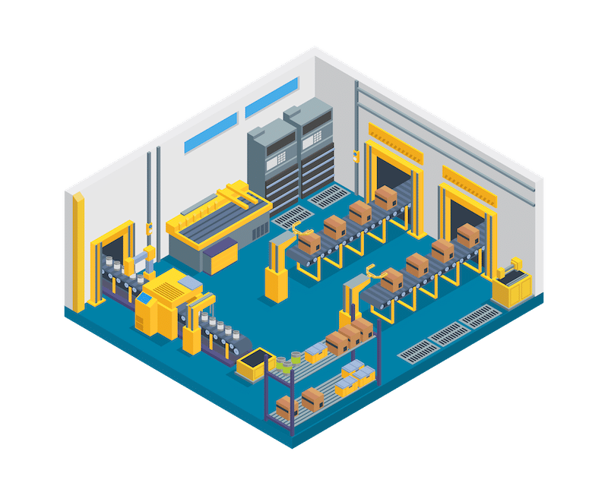








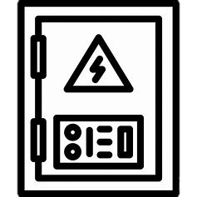


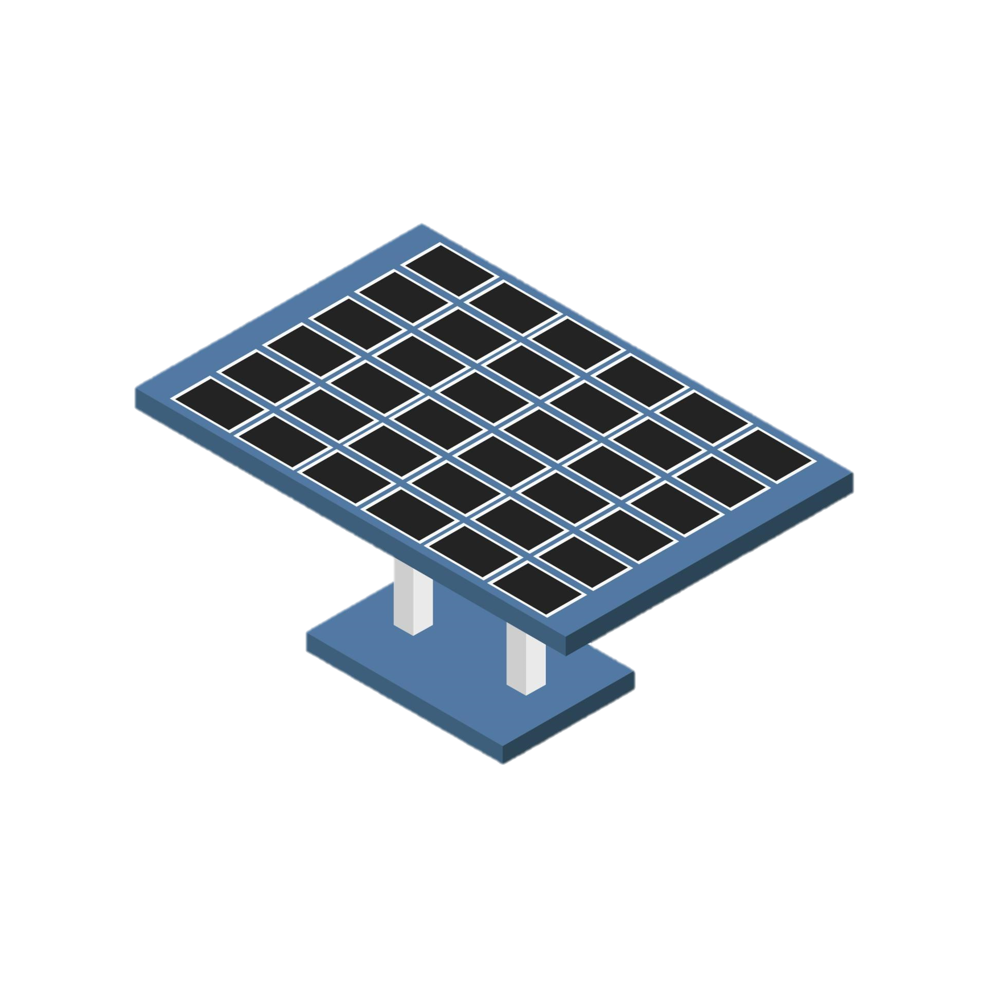

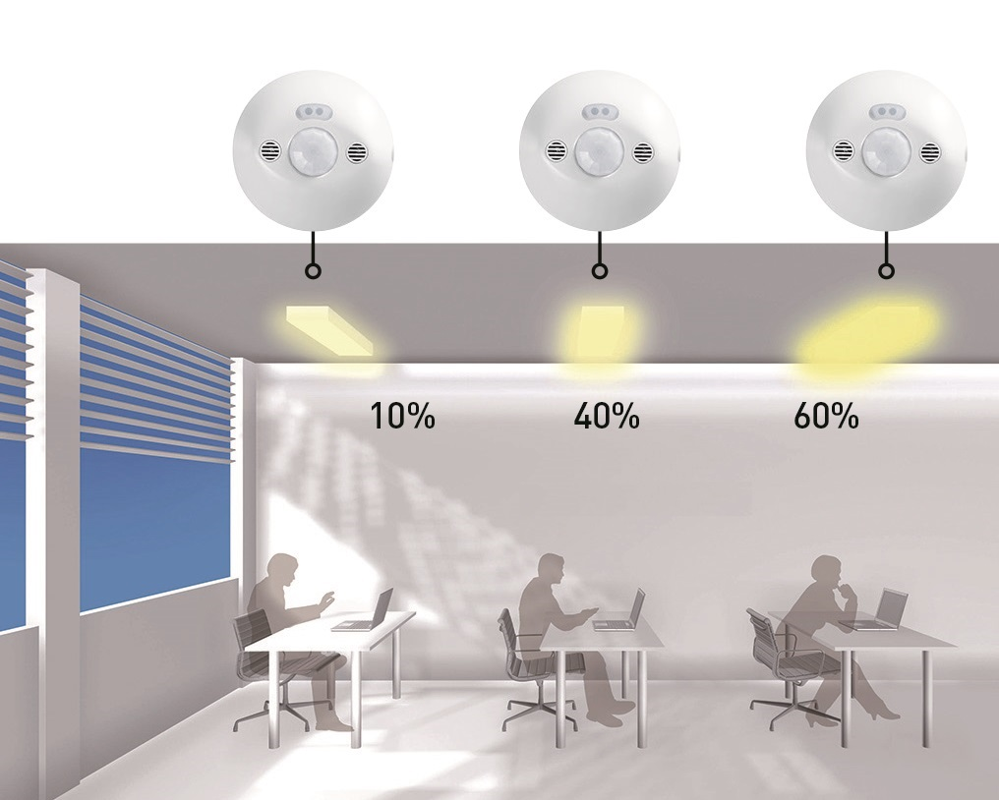
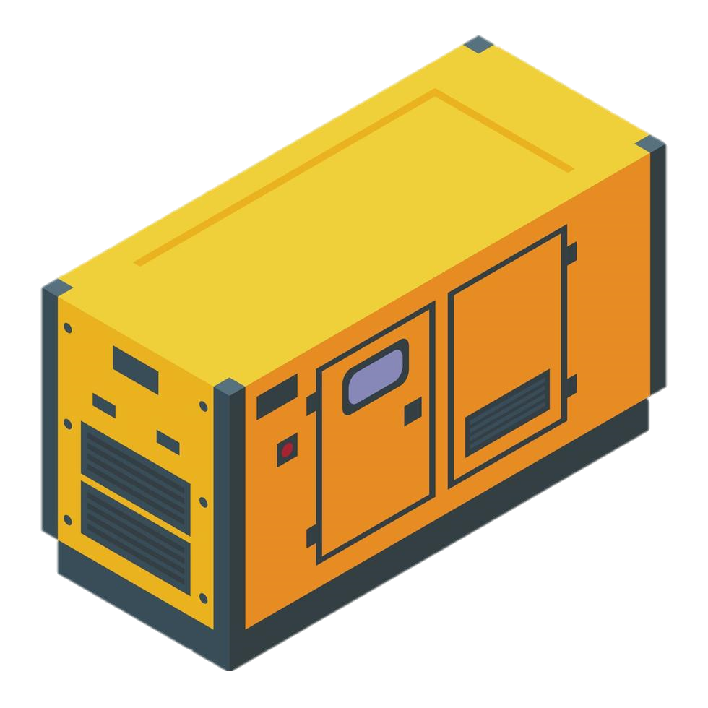

Projects Green GX Dojo
CHARACTERIZATION OF CARBON EMISSIONS GENERATED FROM UTILIZED ENERGY SOURCES.
IoT GX Dojo
GAS ENGINE
Density-Based AC Control
STATE POWER PLANT
IoT LUX Control
DIESEL
CO² Management
SOLAR PANEL
3

Slide 4
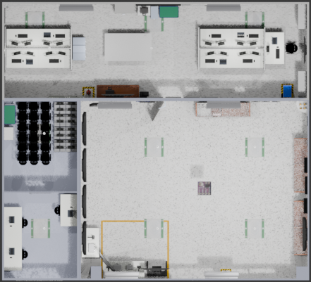
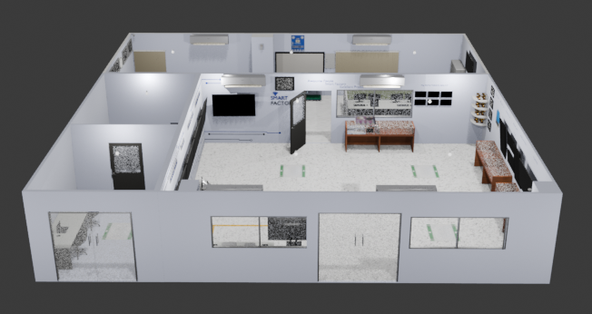
Panasonic Industrial Devices Singapore Pte. Ltd.
PT Panasonic Industrial Devices Batam
3D MODELLING
40 cm
10 cm
44 cm

Slide 5
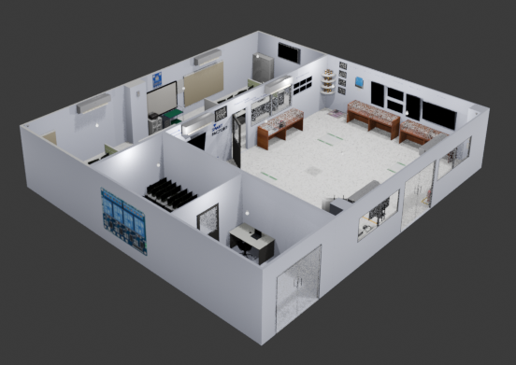
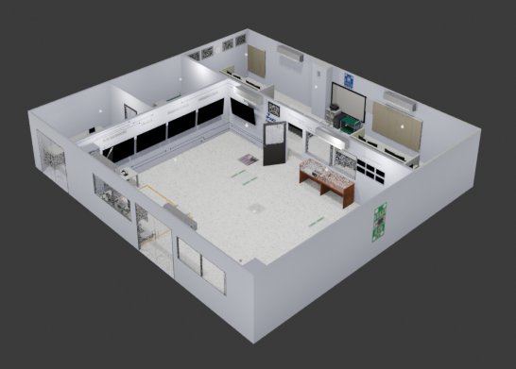
Panasonic Industrial Devices Singapore Pte. Ltd.
PT Panasonic Industrial Devices Batam
3D MODELLING

Slide 6
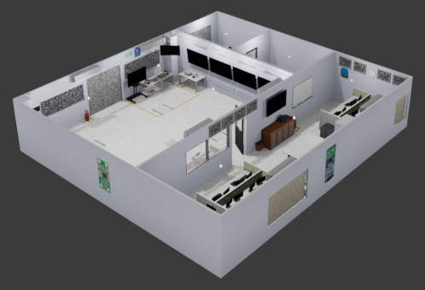
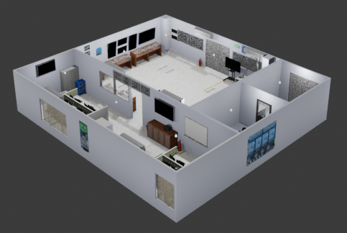
Panasonic Industrial Devices Singapore Pte. Ltd.
PT Panasonic Industrial Devices Batam
3D MODELLING

Slide 7
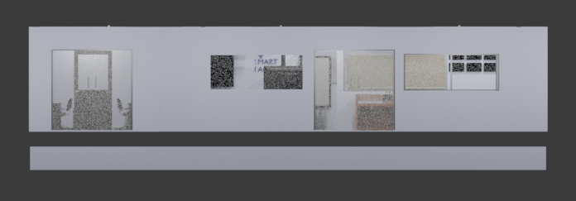
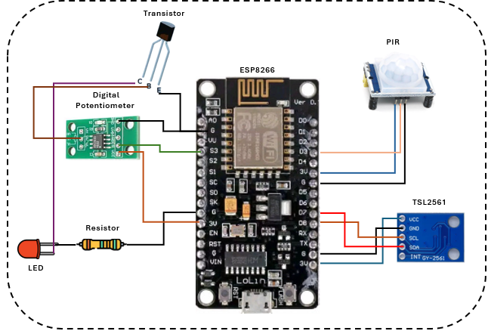
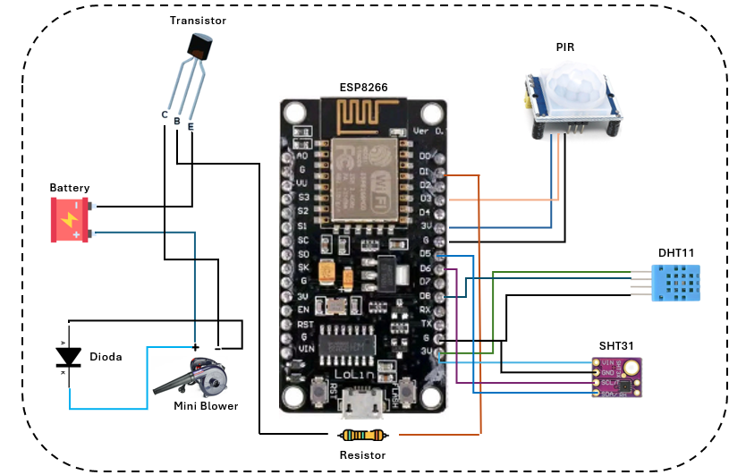
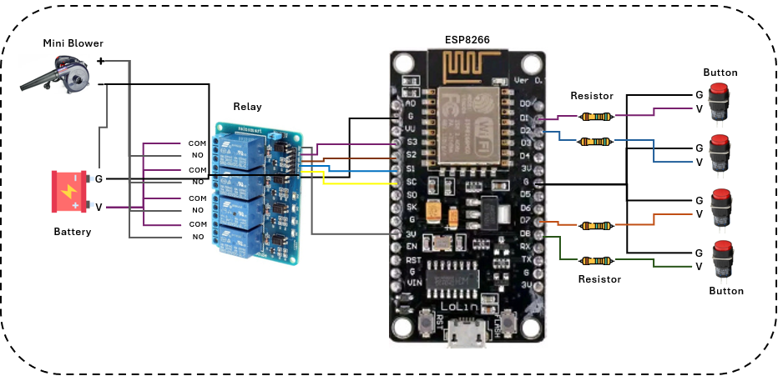
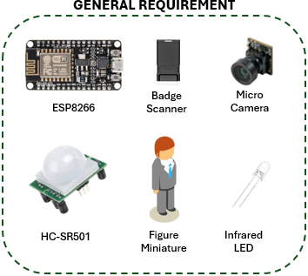
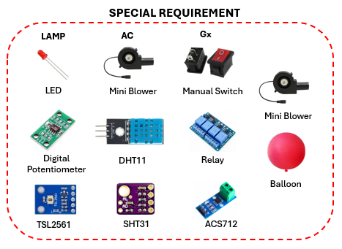
Panasonic Industrial Devices Singapore Pte. Ltd.
PT Panasonic Industrial Devices Batam
WIRING & SENSORS
LAMP MODULE
AC MODULE
CO2 MANAGEMENT MODULE
WIRING
Sensor
Sensor
Wiring will be placed at the bottom of the model to keep it tidy, while several sensors will be installed inside the model.
Sensor
Sensor

Slide 8








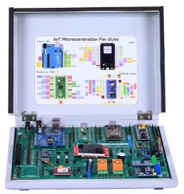





Panasonic Industrial Devices Singapore Pte. Ltd.
PT Panasonic Industrial Devices Batam
GENERAL FLOW TRAINING
1
2
3
Trainer will explain one of the IoT Training Kit content & demo the utility to participant
Trainer will choose one of participant to trying use the IoT Training Kit
Participant will follow trainer instruction for use the IoT Training Kit
5
This flow will be repeated until all the topics of the IoT Training Kit have been explained and tried by the participants
4
There are 3 module in IoT Training Kit that can be played

Slide 9
PBL PROJECT SCOPE & OUTCOMES
Panasonic Industrial Devices Singapore Pte. Ltd.
PT Panasonic Industrial Devices Batam
SYSTEM FLOWCHART
LAMP MODULE
Start
Scan badge
Rooftop close
Choose toy button
Toy moved to specified direction
Light sensor send a signal to Microcontroller
Light sensor scanning area
Microcontroller send a signal to potentiometer
Motion sensor detect movement
Motion sensor send a signal to Microcontroller
Potentiometer adjust brightness
Potentiometer send a signal to lamp
Potentiometer send a signal to lamp
Lamp on
Touchscreen will display the amount energy used and Co2 produced from that
Finish

Slide 10
PBL PROJECT SCOPE & OUTCOMES
Panasonic Industrial Devices Singapore Pte. Ltd.
PT Panasonic Industrial Devices Batam
SYSTEM FLOWCHART
AC MODULE
Start
Scan badge
Rooftop close
Choose toy button
Toy moved to specified direction
Temperature sensor send a signal to Microcontroller
Temperature sensor scanning area
Microcontroller configurate data from the sensor
Motion sensor detect movement
Motion sensor send a signal to Microcontroller
Microcontroller send a signal to AC
AC on
Touchscreen will display the amount energy used and Co2 produced from that
Finish

Slide 11
PBL PROJECT SCOPE & OUTCOMES
Panasonic Industrial Devices Singapore Pte. Ltd.
PT Panasonic Industrial Devices Batam
SYSTEM FLOWCHART
CO2 MANAGEMENT MODULE
Start
Scan badge
Rooftop close
Choose energy button
Relay open the current
Microcontroller send a signal to mini blower
Power sensor send a signal to Microcontroller
Power sensor measure the energy that have been used
Object use the energy
Mini blower blowing the balloon
Touchscreen will display the amount energy used and Co2 produced from that
Balloon has filled
Finish

